Slide 1
Internet of Things and home automation
Martin Harizanov

Slide 2
Agenda
Introduce myself
What is IoT
Why IoT?
My home automation system architecture
Q/A

Slide 3
About
IT Project Manager/Business Analyst/Business Intelligence/Data warehousing
Hobbies include IoT/home automation
I am active in the IoT Open Source/Hardware community
Blogger
My education background combines software and hardware

Slide 4
What is IoT?
Internet of Things
Internet connected objects (things) working together to solve a business problem
Has been around for quite a while, but only recently has become affordable for personal use
Notes:
It isn’t coming soon .. it is already here and has been so for quite a while
Connects billions of sensors and devices from every day consumer objects to industrial equipment

Slide 5
What are the “Things” in the IoT?
Could be anything
Physical
Virtual
Notes:
Physical
Objects such as
Climate control
Security/Disaster alarm system
Energy/Resource metering (Electricity, Gas, Water)
Water boiler, Solar boiler
Car (OBDII, vehiclepi)
The Sun (sunrise/set times, azimuth)
Living things
People (self quantification)
Presence
Location
Health metrics
Weight
Activity tracking
Temperature
Blood Glycose monitors
Fitbit
Pets
Virtual
Personal schedule/calendar
Social
Email
Twitter/FB
Online notification platforms
WWW resources
Weather forecasting
Stocks
Traffic
DB Storage
Visualization dashboards
Presence

Slide 6
Why IoT?
Generate, collect, process and use acquired information to make better decisions
Smart objects: Make things that weren’t meant to talk to each other interact smartly
Gartner says the Internet of Things installed base will grow to 26 Billion units by 2020; I want to be well aligned and prepared for that
Notes:
Provide intelligence
Improve efficiency

Slide 7
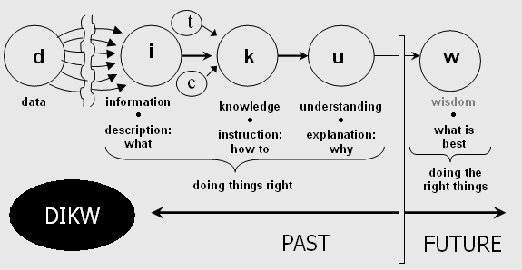
Generate, collect, process and use acquired information to make decisions
DIKW model
Information is inferred from data, in the process of answering interrogative questions (e.g., "who", "what", "where", "how many", "when"), thereby making the data useful for "decisions and/or action".
Knowledge as "synthesis of multiple sources of information over time"
Notes:
There is more to data that meets the eye
E.g. Momentary power of solar boiler based on the rate of temperature increase of fixed volume of water
Shape of power waveform reveals the appliance
Dew point from temperature and humidity
Presence from ping times
If you can’t measure it, you can’t improve it
Example (home scale, imagine on industrial scale)
Power usage
AC compressor heater element consumes ~140W, even when AC is off
TV using 120W in standby mode
Circulation pump UPS consuming 100W in standby mode
Laser printer occasionally using 400W in standby mode to warm up toner
Dishwasher in delayed start mode consumes 150W till program starts
..and many more

Slide 8
Smart objects: Make things that weren’t meant to talk to each other interact smartly
Phone → Location detection, presence detection → Thermostat
Doorbell activation → CCTV takes picture→ Email + SMS + Tweet
Fire Alarm → Email + SMS
Security System→ CCTV → Email + SMS
Climate control → presence @ home & weather forecast
Hot water tank 1 ← → Hot water tank 2 ← → our presence, weather forecast
Dog→ CCTV + Email
Weather notifications → email

Slide 9
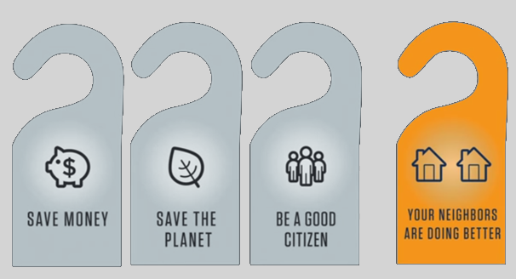
Influence others to reduce their carbon footprint by sharing socially your metrics
Alex Laskey: How behavioral science can lower your energy bill
https://www.youtube.com/watch?v=4cJ08wOqloc
My @iot_house tweets power consumption statistics

Slide 10
Challenges
Global cooperation
Proprietary and incompatible protocols
Lack of APIs
Example: Common external power supply
Technological challenges
Power usage
Scalability
Security
Communication mechanisms
Ethics, control society, surveillance, consent and data driven life
Notes:
Proprietary and incompatible protocols even from same manufacturer as part of their business model

Slide 11
Overall Architecture
Storage
Visualization, BI
Business logic
Control UI
Logic
M2M
Thing
Interface
Read properties
Protocol
Interface
Protocol
Protocol
Raw
Processed
Set Property
Protocol
Notes:
Data produced by the connected things is acquired, processed and logged; DQ, what data to collect (collecting nothing with great accuracy)
Run on a R/O fs raspberry pi; considering moving to the cloud
As “Things” become increasingly smarter, they can talk directly to M2M layer
It is possible to have multiple interfaces on the same “Thing”, specializing on interfacing with certain its property (AC power, temperature, control)
It is possible that multiple interfaced “Things” have one and the same interface on the M2M end, as long as they use same protocol
Storage: Abstract and treat a “thing” with “interface”. EmonCMS, ThingSpeak, NoSQL; Retrieval of data API;
Visualization: in-built EmonCMS, Thingspeak; collect an relate data for better insight. Actionable analytics.

Slide 12
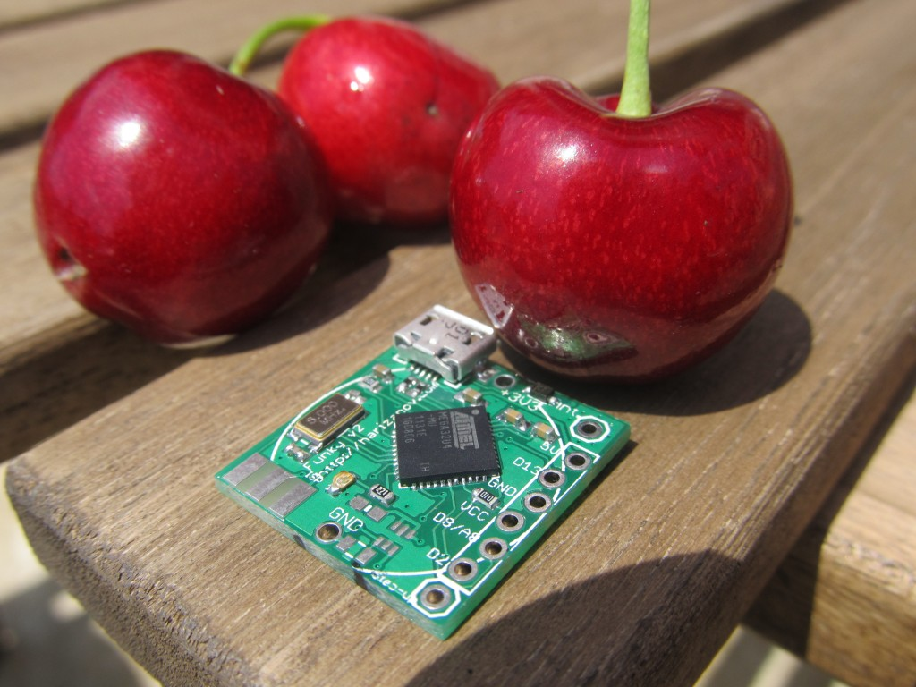
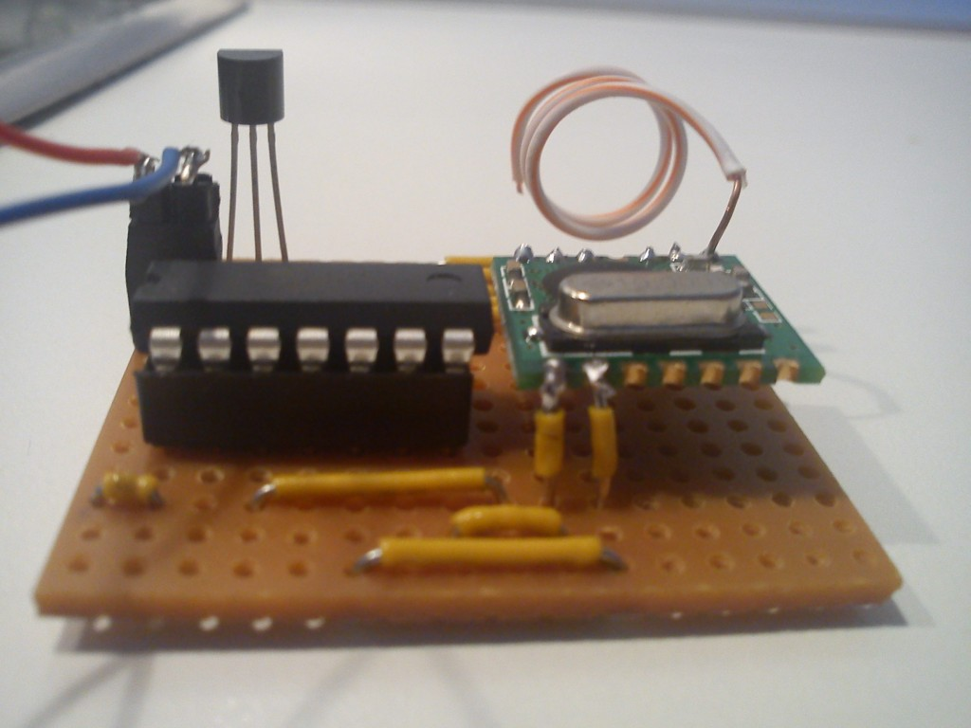
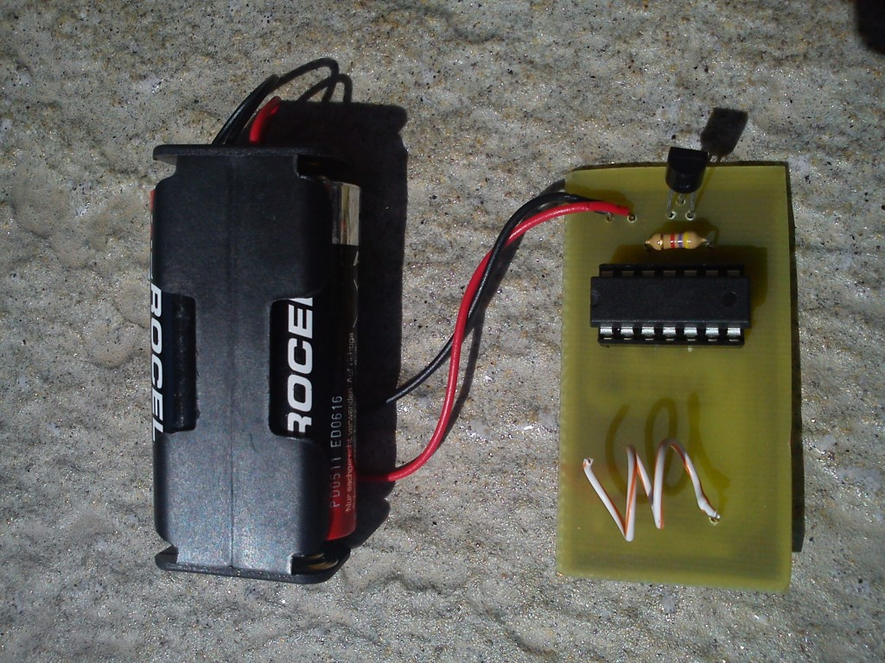
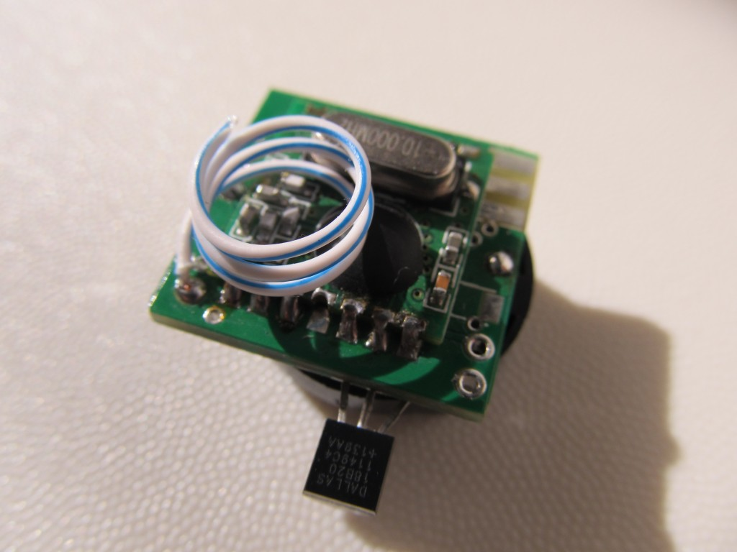
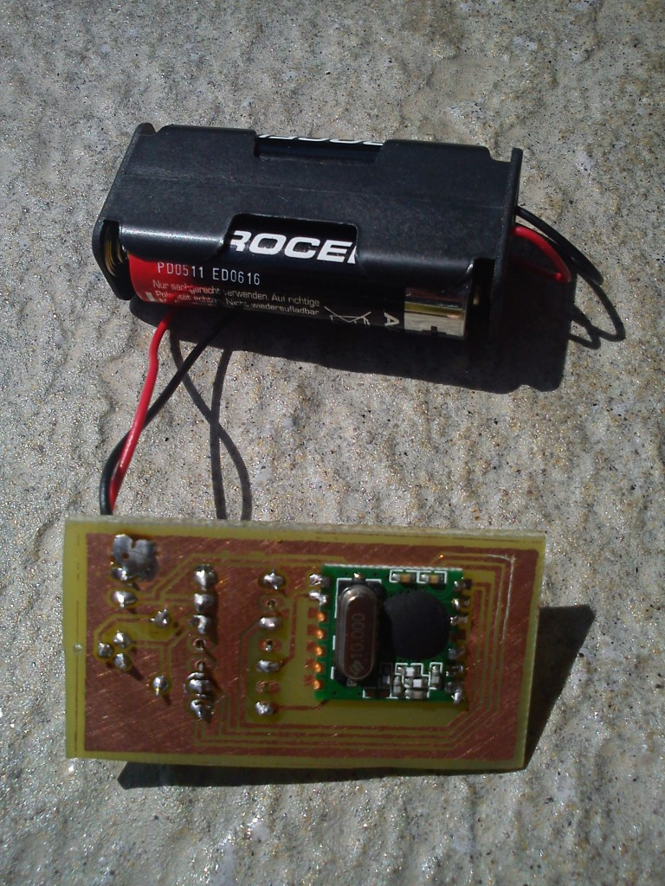
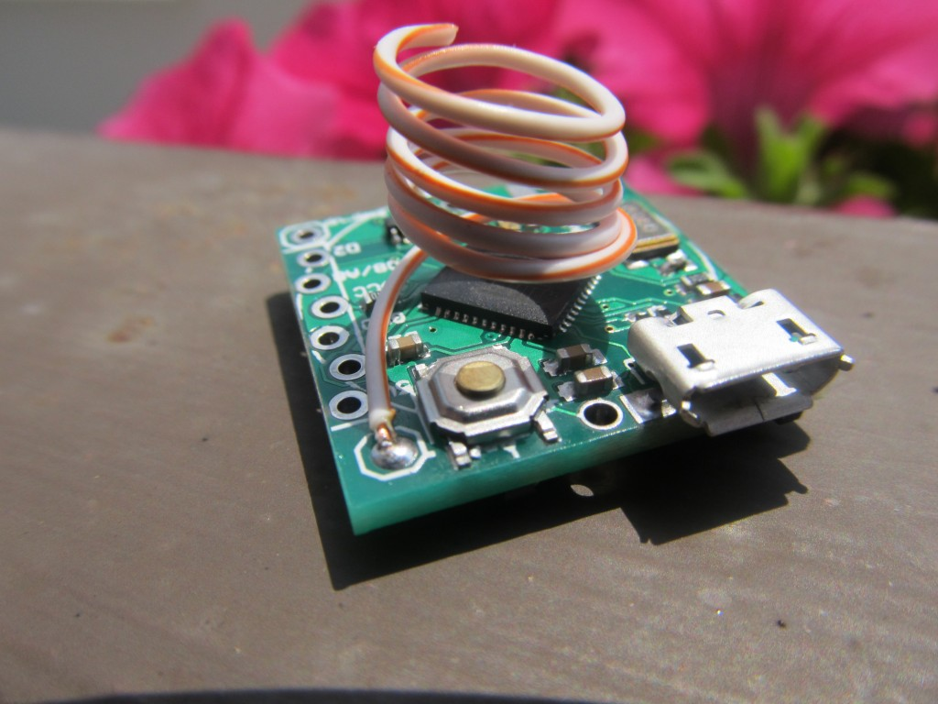
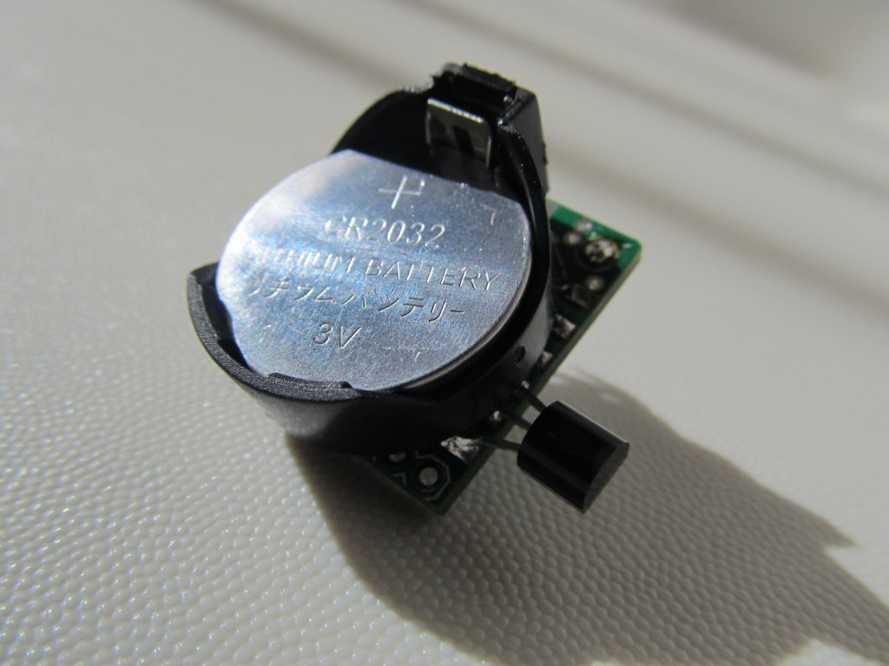
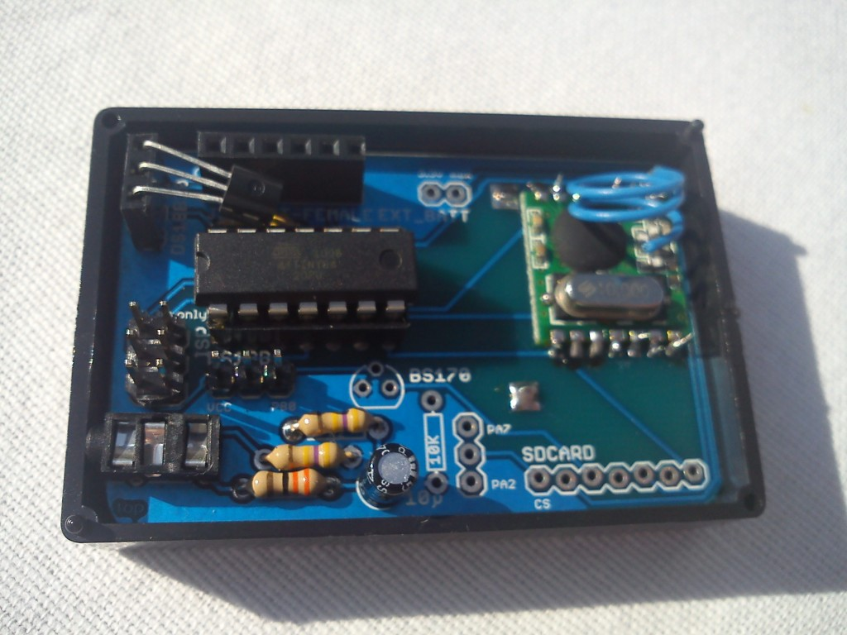
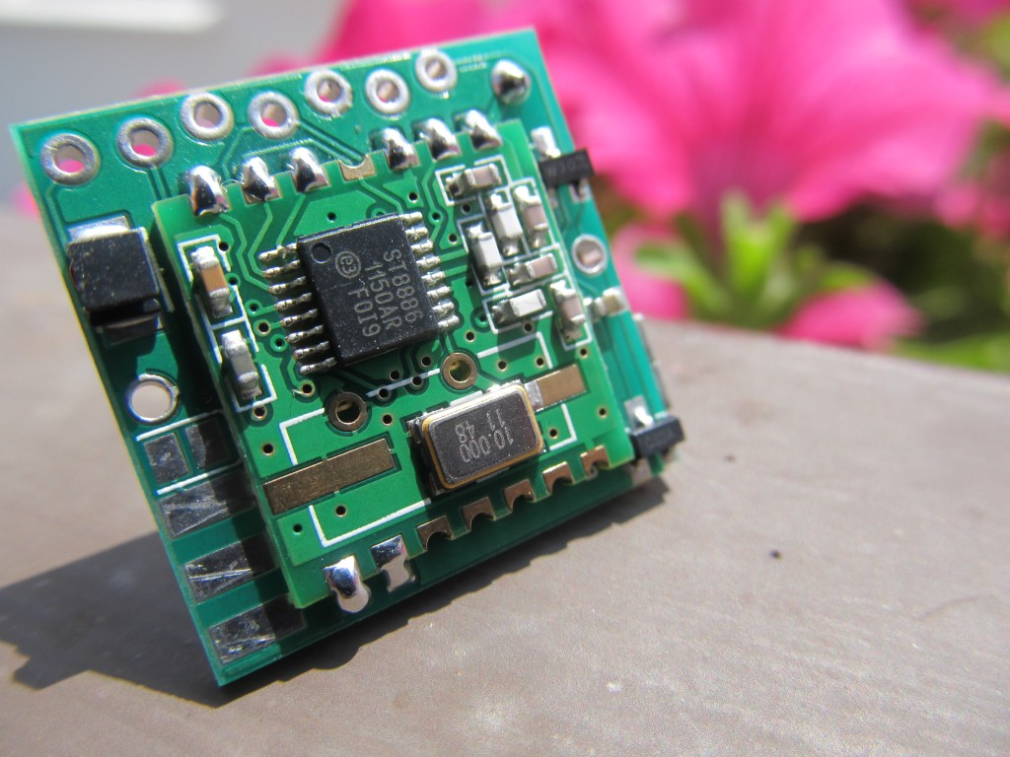
The hardware interface to “things”
The ‘Funky’ project
It is an Arduino-compatible multi purpose micro that is:
Very small: 20×21.2mm (0.78″x0.83″)
Very light: 3 grams
Low power (up to 1 year on coin cell battery)
Wireless capable (RFM12B transceiver)
Notes:
I’ve created a miniature Arduino compatible clone with wireless connectivity to use as interface to physical objects. The project is open hardware/source.
YAPM,

Slide 13
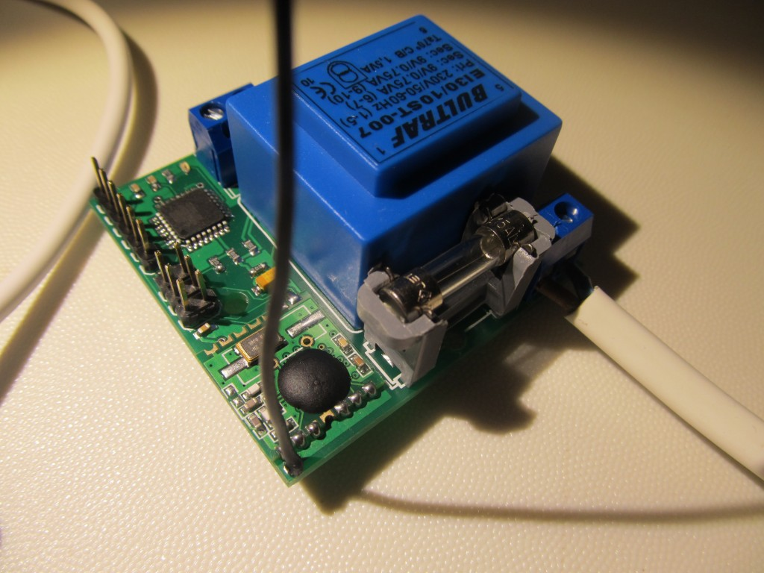
YAPM (Yet Another Power Monitor)
Wireless Power Monitor project

Slide 14
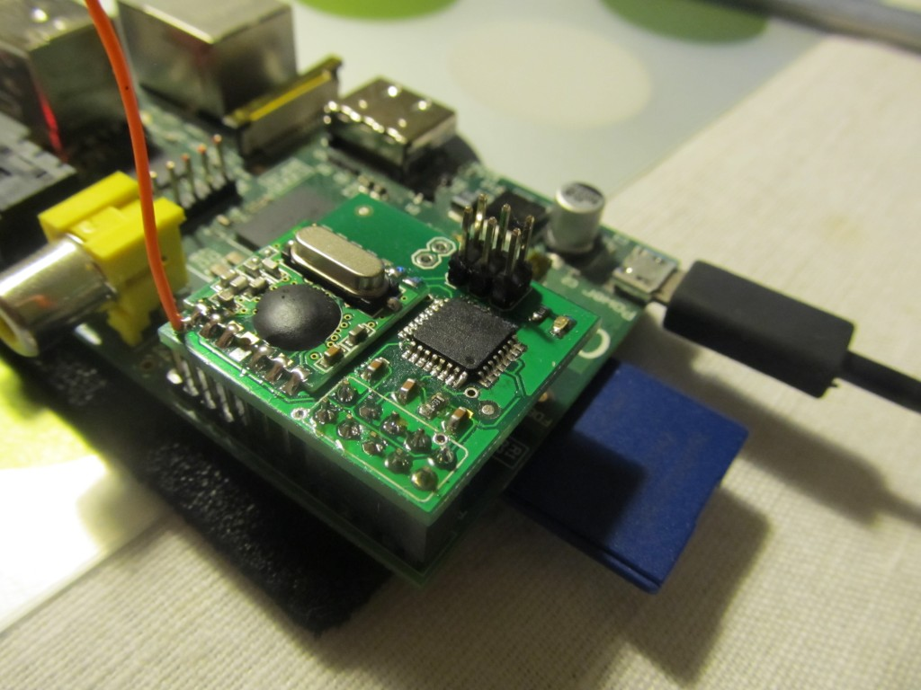
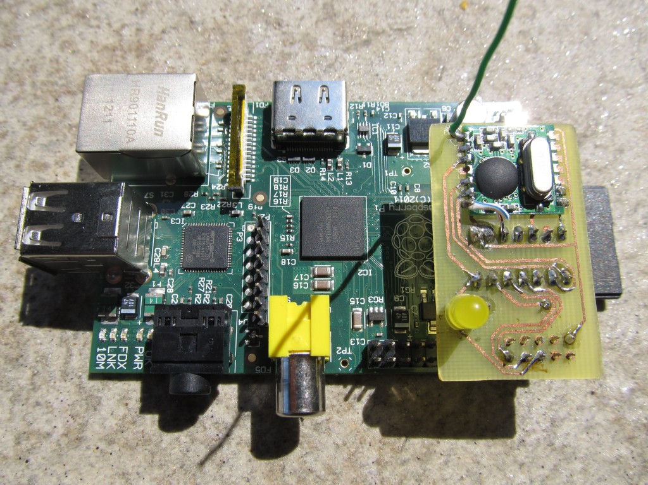
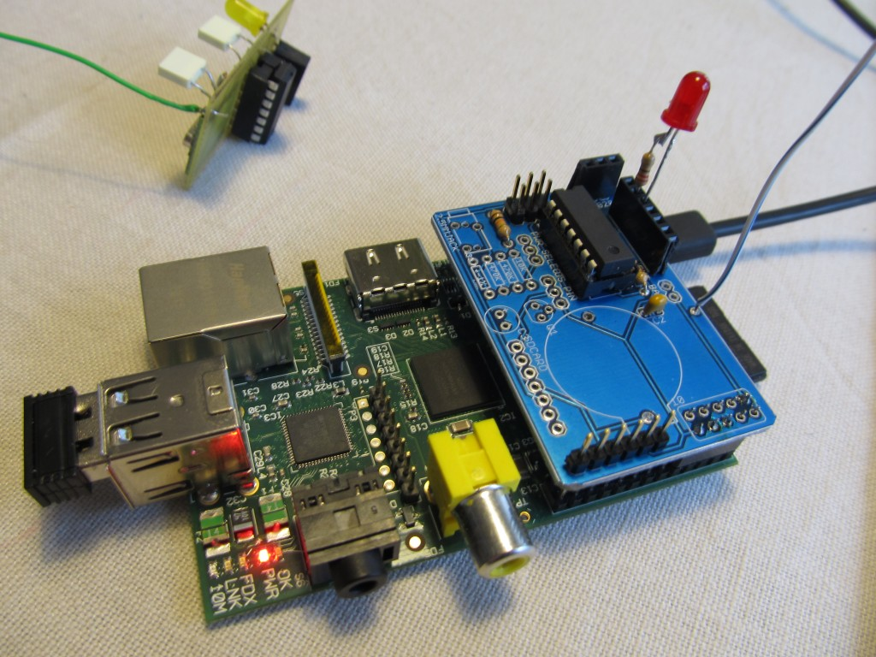
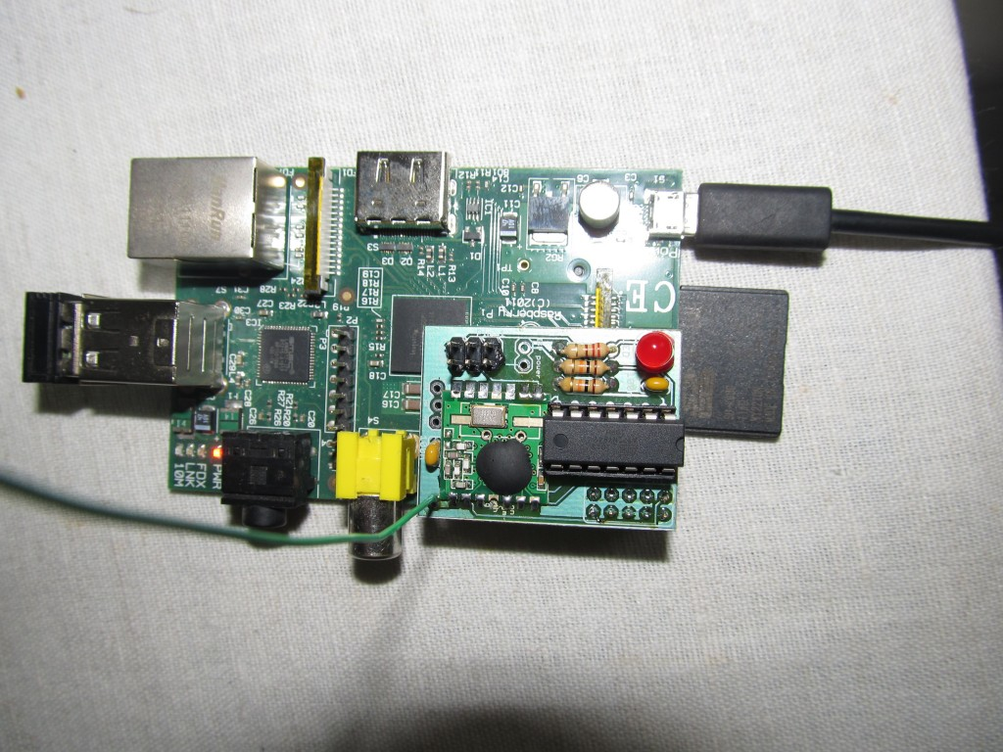
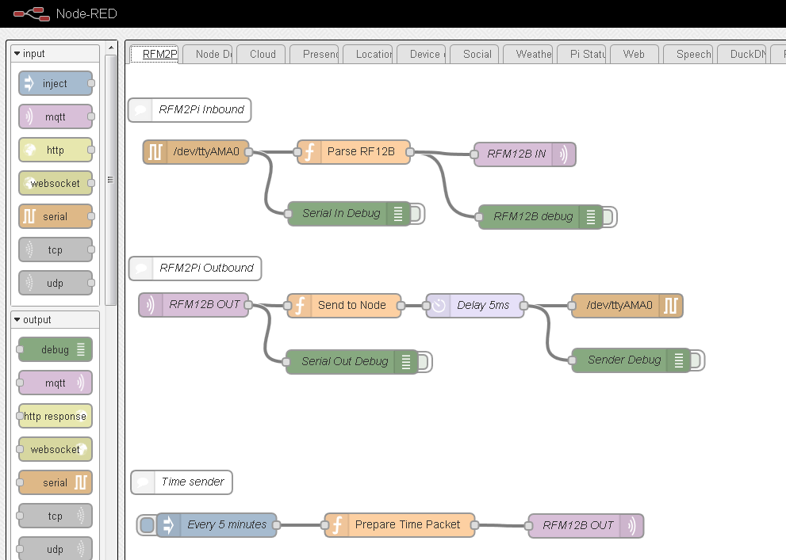
Receiver module
The ‘RFM2Pi’ project
It is an Arduino-compatible board that acts as a wireless bridge between wireless remote nodes and the M2M layer

Slide 15
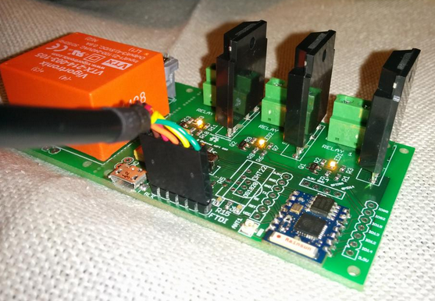
ESP8266 WiFi relay/thermostat project

Slide 16
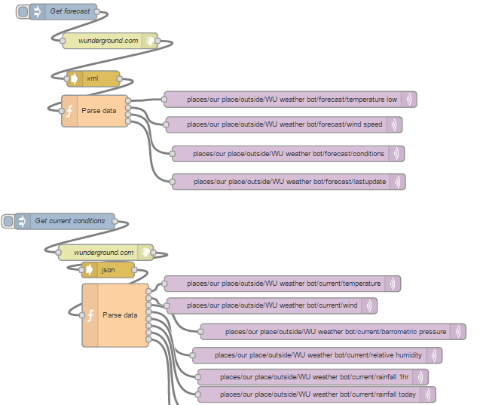
Software Interface example
NodeRED weather forecast/current conditions

Slide 17
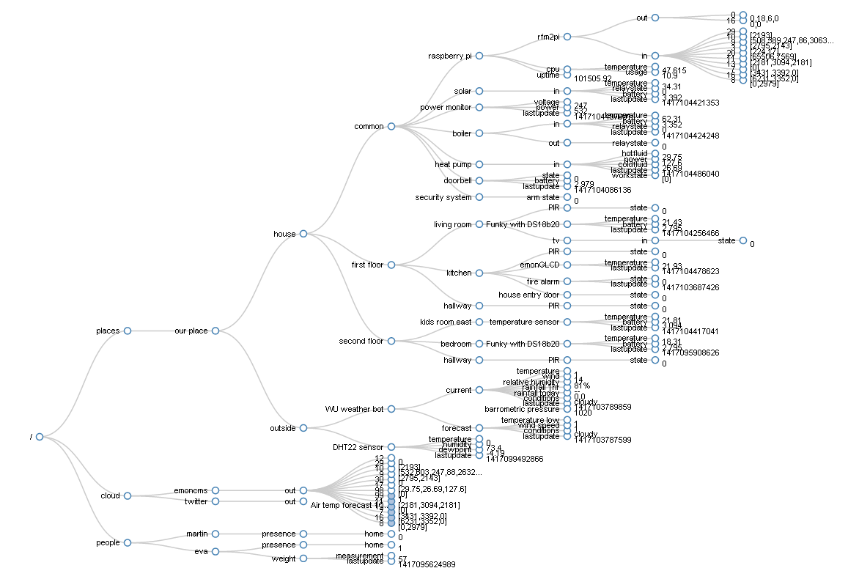
Machine to Machine
Using mosquitto MQTT broker, extremely lightweight publish/subscribe messaging transport protocol
My MQTT topic tree structure:

Slide 18
Business logic layer
Using Node-RED
Very visual, drag-and-connect
Encapsulates all logic in single JSON file
Examples
Remote sensor data processing
Speech recognition/generation
Control UI
Dynamic DNS updater
Notes:
Speech NR demo

Slide 19
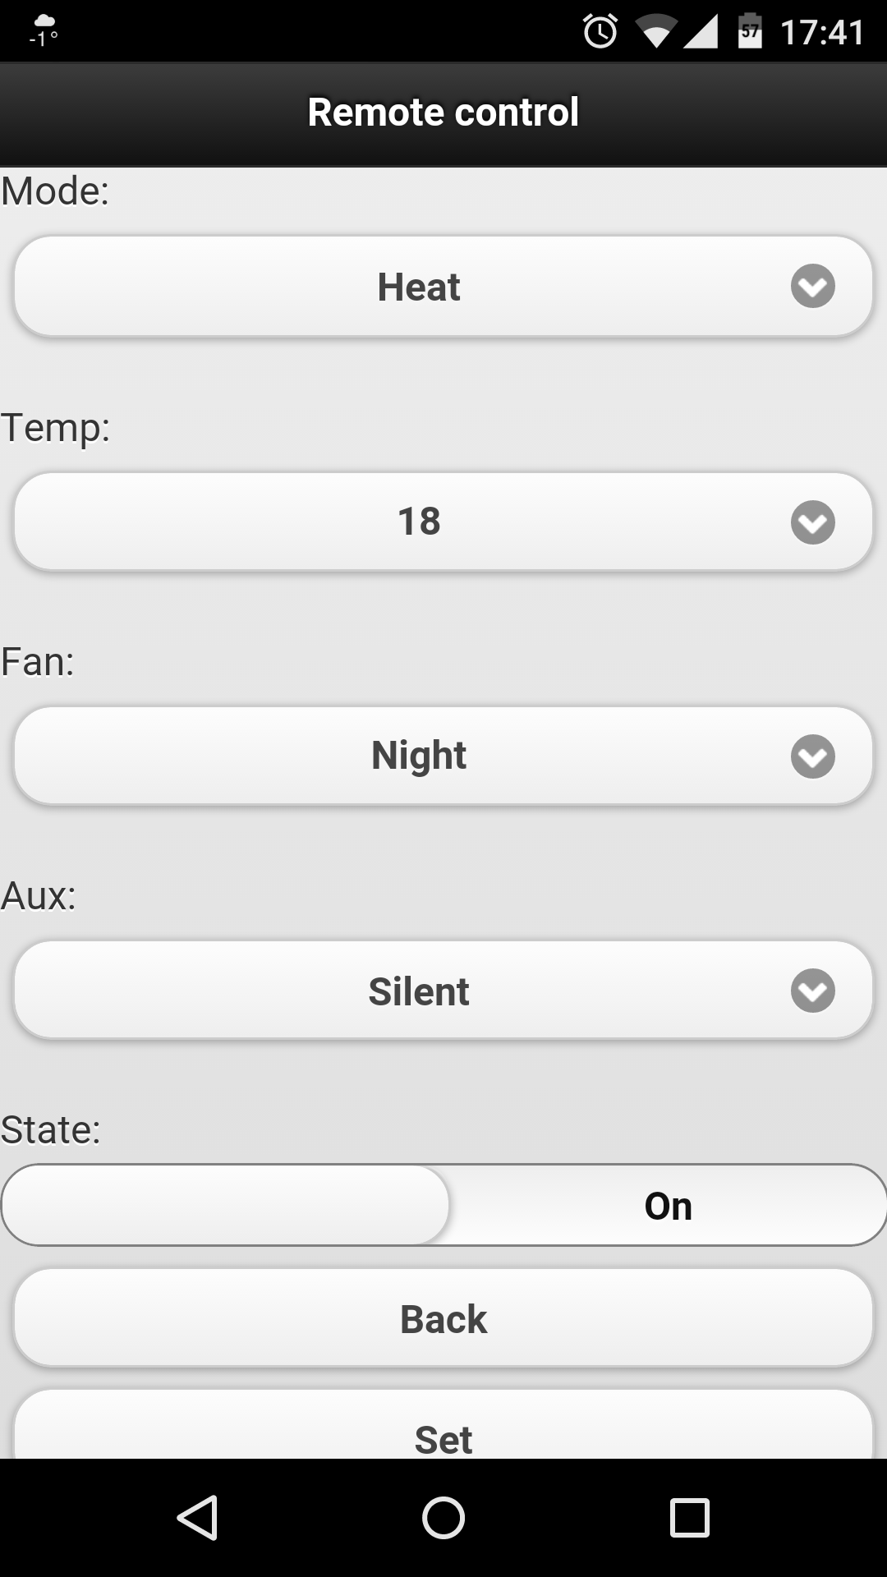
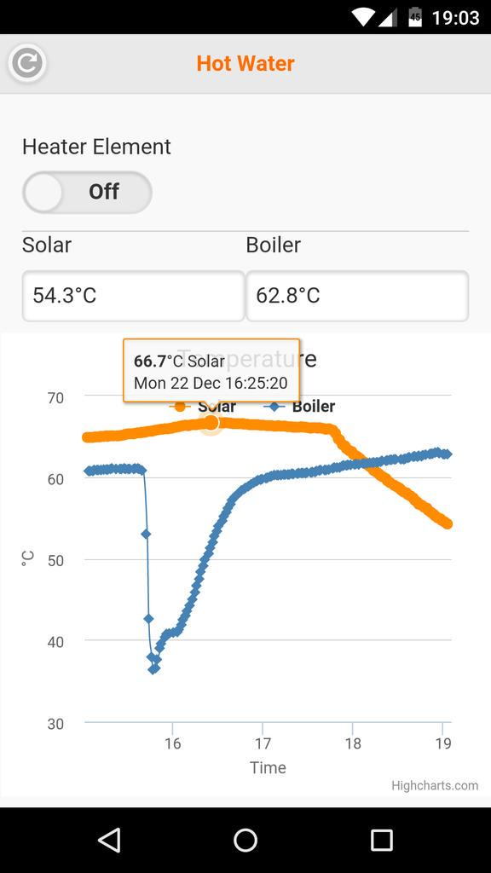
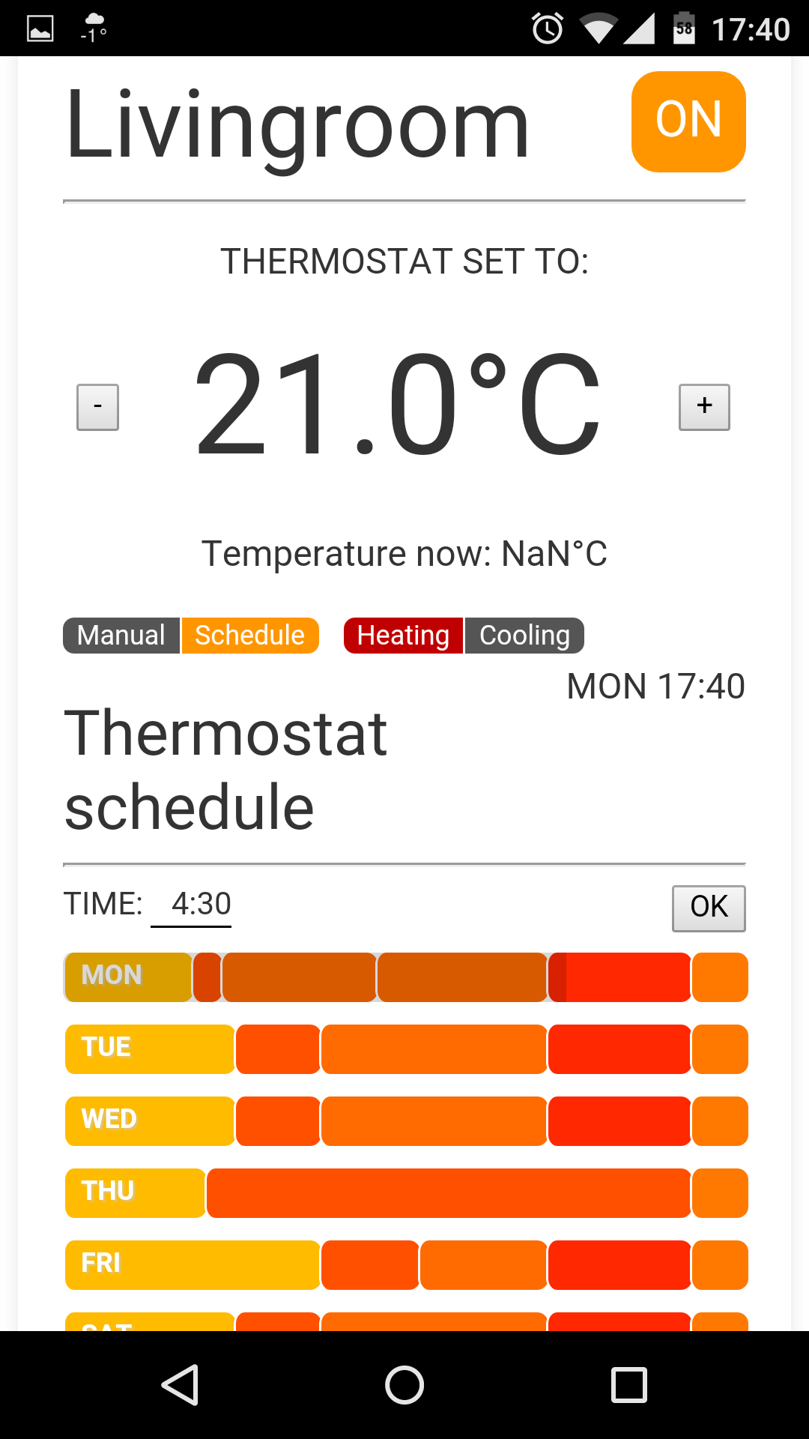
Control UI
Notes:
Need to work on consolidating these
OpenHab?

Slide 20
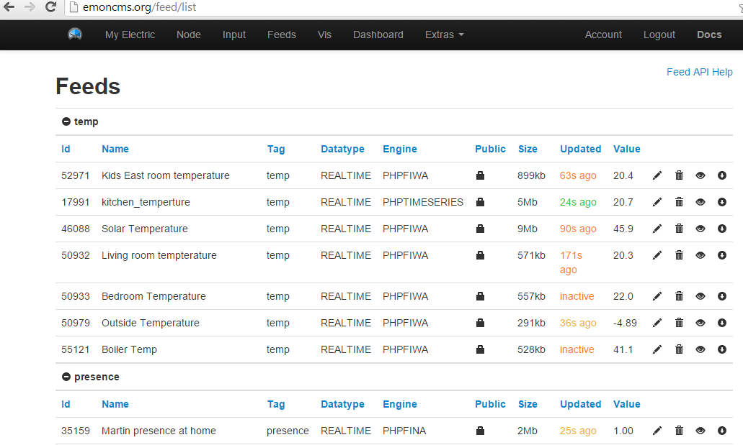
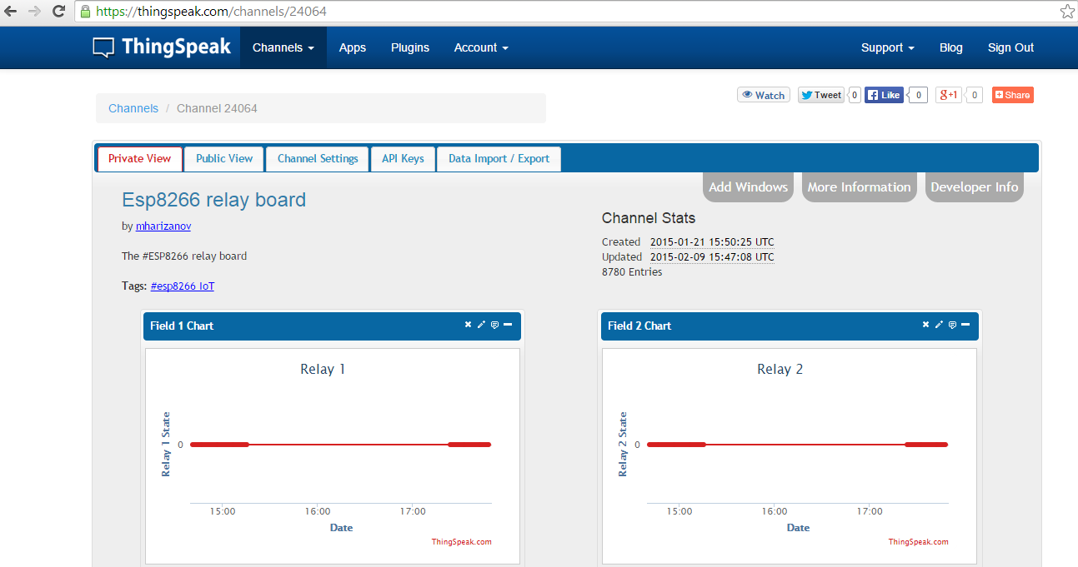
Storage

Slide 21
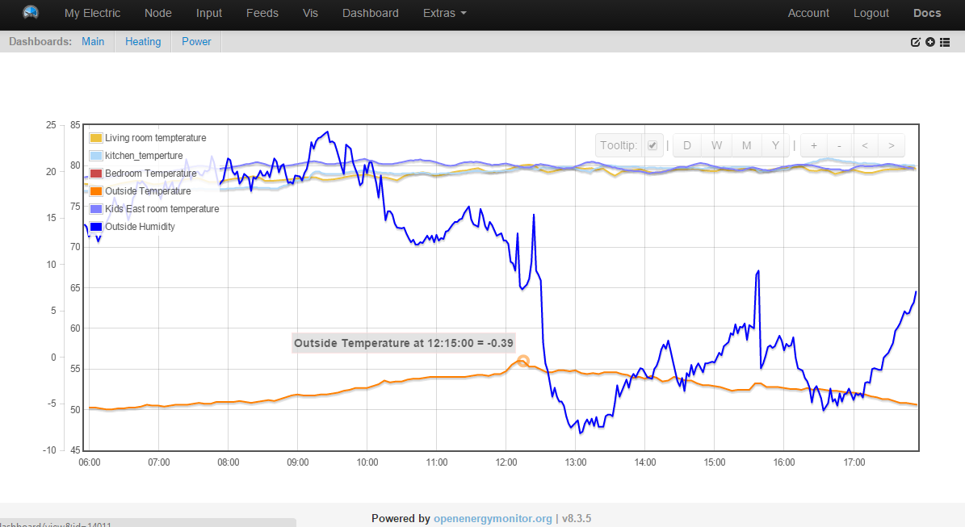
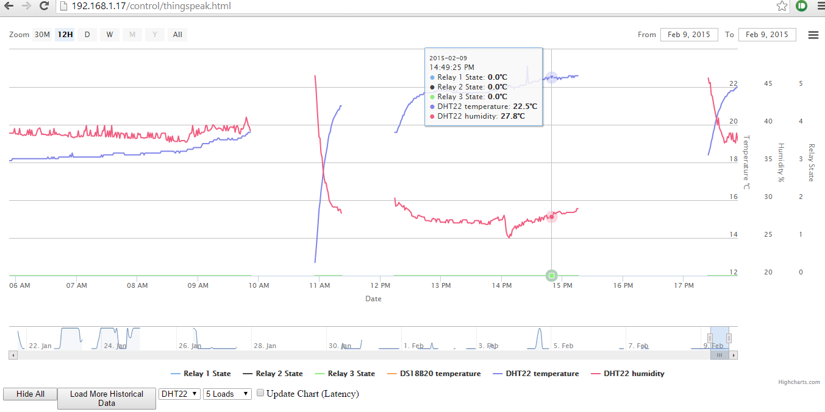
Visualization

Slide 22
End
Thanks!

Slide 23
Questions?

